Slide 1

AI Safety System: Intelligent Critical Event Detection
This project introduces an AI-powered safety system designed to automatically detect critical events using advanced audio and visual analysis. By leveraging sophisticated machine learning models, the system significantly enhances situational awareness and enables faster, more efficient responses to emergencies.

Slide 2

Team & Supervision
Project Team:
Supervised By:
Maya Anwar
Dr. Ghada Khoriba
Nada Ibrahim
Machine Learning Course: AIS301
Mohamed Montasser
Youssef Barkat
Mohamed Khaled

Slide 3

Abstract: Bridging the Surveillance Gap
Traditional surveillance heavily relies on human operators, leading to potential delays or missed incidents due to fatigue and limitations. This AI safety system addresses these challenges by automating critical event detection through integrated audio and visual analysis.
"By leveraging machine learning, our system enhances situational awareness, reduces reliance on human monitoring, and enables a significantly faster response to emergencies."

Slide 4

Introduction: The Need for Intelligent Safety
The growing demand for intelligent safety systems has accelerated the adoption of machine learning for automated monitoring. The AI Safety System aims to improve situational awareness by detecting abnormal or dangerous events with minimal human intervention, thereby enhancing overall security and response capabilities.
Problem Statement: Human-based surveillance systems often suffer from fatigue, slow response times, and limited scalability. There is a critical need for an automated, real-time solution capable of accurately detecting critical events.

Slide 5





Key Objectives
Automated Event Detection
To automatically detect critical and abnormal events, reducing the need for constant human vigilance.
Reduce Human Reliance
Minimise dependence on human monitoring, mitigating issues like fatigue and oversight.
Real-time Alerts
Provide instantaneous alerts to facilitate rapid intervention and response.
Enhance Safety
Improve safety across diverse environments through proactive detection and response mechanisms.

Slide 6
System Overview: Comprehensive Detection
The AI Safety System captures environmental audio and images, extracts pertinent features, and applies machine learning models to identify a range of emergencies.
Violence / Fights
Fire / Smoke
Crashes / Breaking
Distress Screams
Detection of physical altercations or aggressive behaviour.
Identification of fire outbreaks or the presence of smoke.
Recognition of loud impacts or shattering objects.
Analysis of audio for human screams indicating distress.
Abnormal Behaviour
Identification of unusual movements or patterns deviating from norms.
Upon detection, the system generates real-time alerts to facilitate rapid response.

Slide 7
Machine Learning Models Utilised
The AI Safety System integrates a variety of machine learning models to ensure accurate and robust critical event detection. This multi-model approach enhances the system's ability to identify diverse threats effectively.
Convolutional Neural Networks (CNN)
Random Forest
Support Vector Machine (SVM)
Logistic Regression
K-Nearest Neighbors(KNN)

Slide 8





Tools & Technologies
Our AI Safety System leverages a robust stack of tools and technologies to ensure efficient development, training, and deployment.
Python
Google Colab
ML Libraries
Core programming language for system development.
For model training and experimental workflows.
Specialised libraries for building and optimising models.
GitHub
Google Drive
Version control and collaborative development.
Secure storage for datasets and trained models.

Slide 9

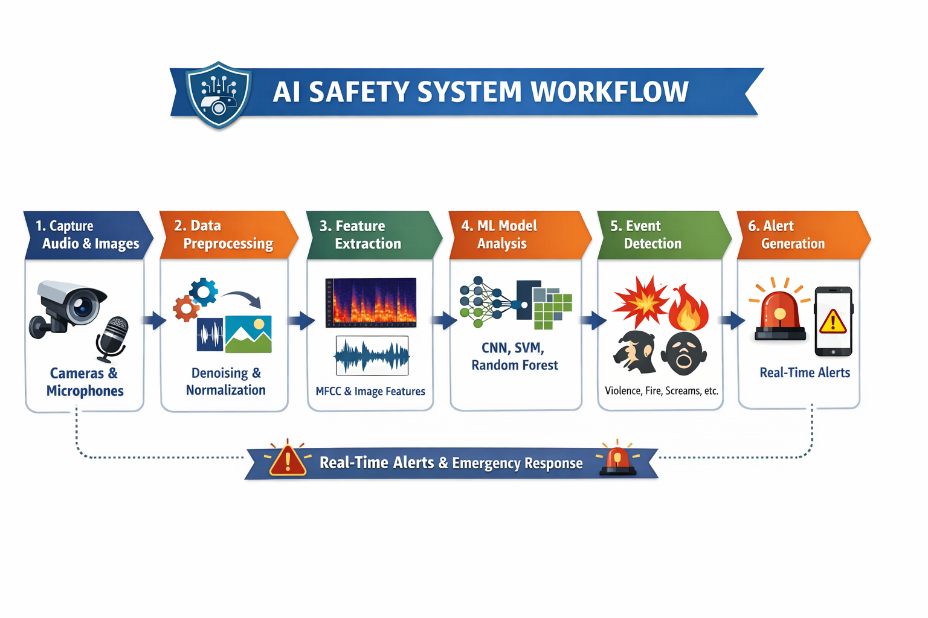





Operational Workflow
The system follows a streamlined workflow from data acquisition to alert generation, ensuring efficient and timely critical event detection.
Data Capture
Audio and images from cameras and microphones.
Preprocessing
Denoising, normalisation, and resizing of raw data.
Feature Extraction
MFCC for audio, pixel features for images.
ML Application
Deployment of CNN, Random Forest, SVM, etc.
Event Detection
Critical events identified by trained classifiers.
Real-time Alerts
Notifications for operators or automated systems.

Slide 10

Conclusion & Applications
This AI Safety System effectively combines classical and machine learning models for automated critical event detection. By integrating audio and visual data, the system significantly enhances safety, minimises human error, and provides real-time, actionable alerts, offering a reliable alternative to traditional surveillance.
Key Applications:
Campuses and Educational Institutions
Public Spaces and Transportation Hubs
Hospitals and Healthcare Facilities
Advanced Surveillance Systems
Factories and Industrial Sites

